Slide 1
Graphics Project: A Football Field using OPENGL
Department of computer science and engineering Khulna university of engineering & technology, Khulna

Slide 2
Outlines
Introduction
Library Used
Textures used
Types of light shedding used
Different Views of Stadium
Control Keys
Conclusion
References

Slide 3
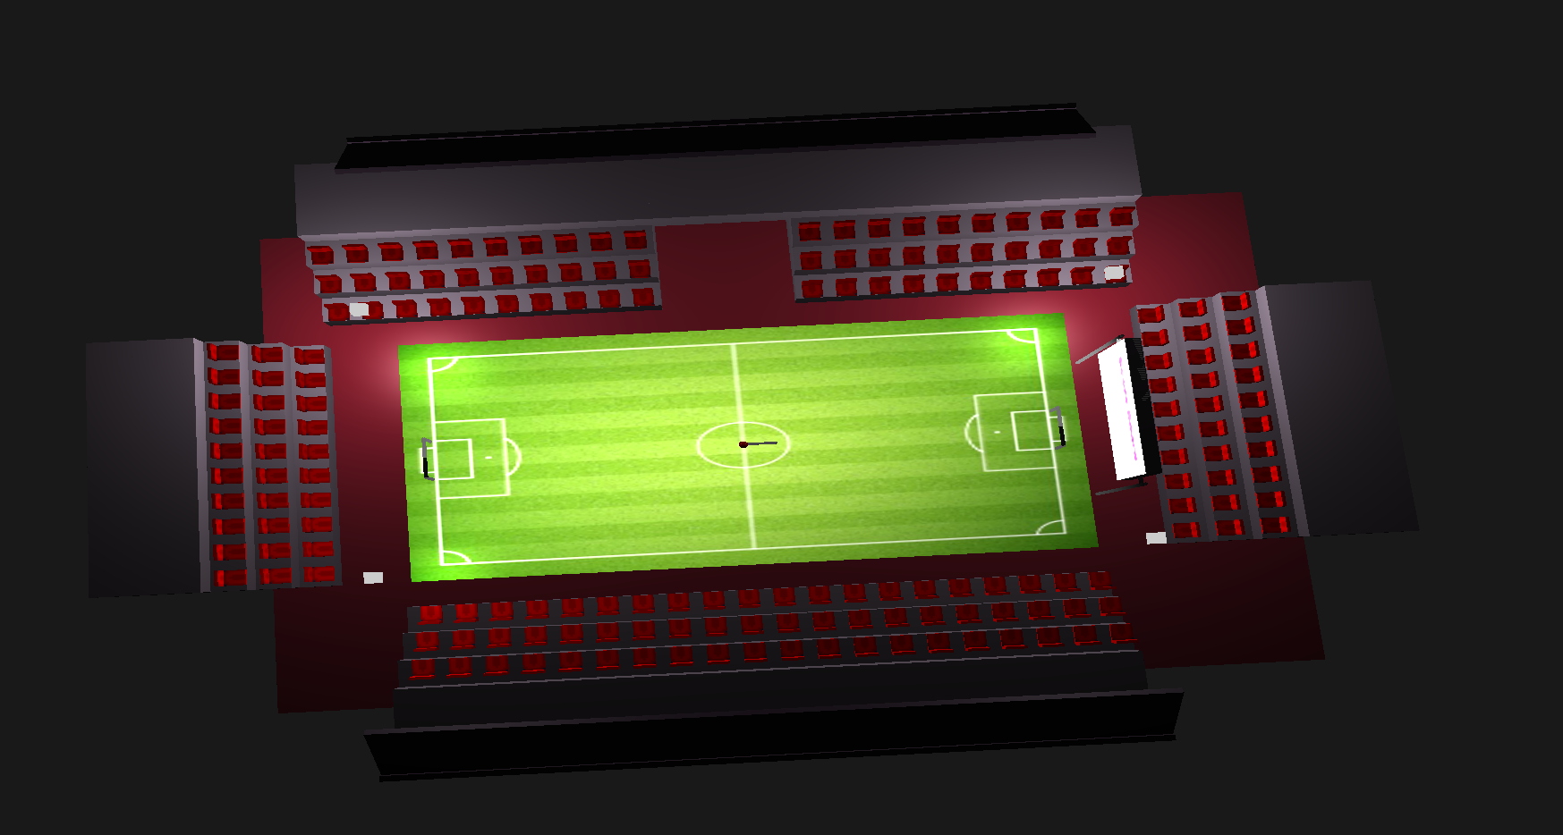
Introduction
The project revolves around a football stadium and is built using OpenGL 3.3.
Fig 1.1: Overview of Football stadium

Slide 4
Libraries Used
Glad: Glad is a straightforward and simple loader generator that manages OpenGL function pointers, enabling easy and efficient management of OpenGL extensions
GLFW: GLFW is a multi-platform library for creating windows, contexts, and handling input, useful in OpenGL applications
Glm: GLM is a mathematics library designed for graphics software; it provides vector and matrix operations compatible with OpenGL Shading Language (GLSL)
Stb_image: stb_image is a simple C library for loading image files; it's lightweight and easy to integrate into various projects for image loading

Slide 5

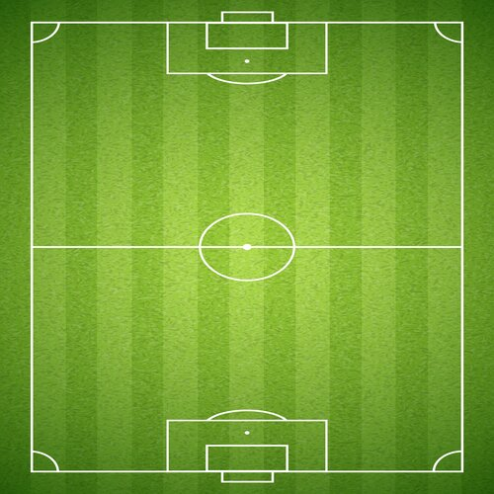


Textures used
Textures used in the following project is given below:
Fig 1.2: Game over
Fig 1.3: Field
Fig 1.4: Chair
Fig 1.5: Scoreboard

Slide 6
Type of light used
Point light
Directional light
Spot light

Slide 7
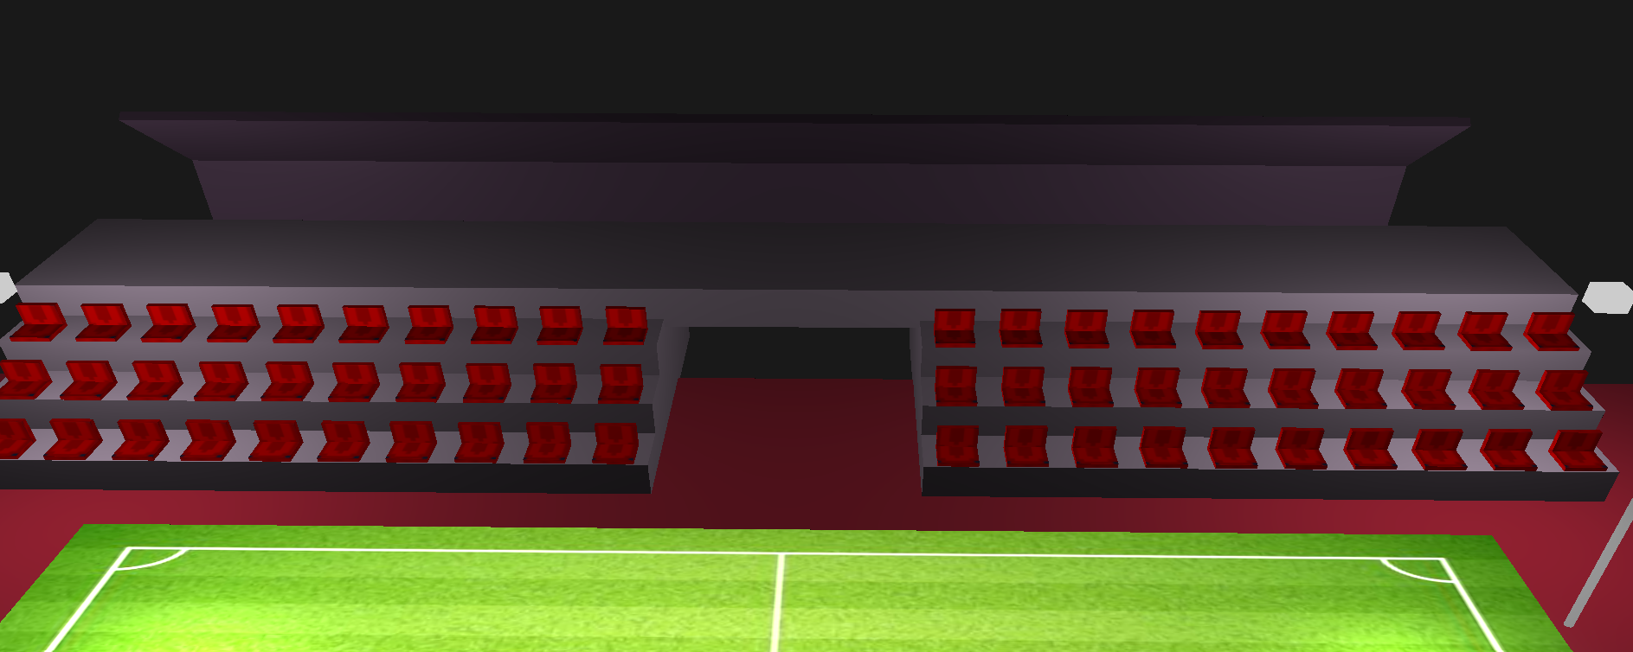
Different views of stadium
East Gallery
Fig 1.6: East Gallery

Slide 8
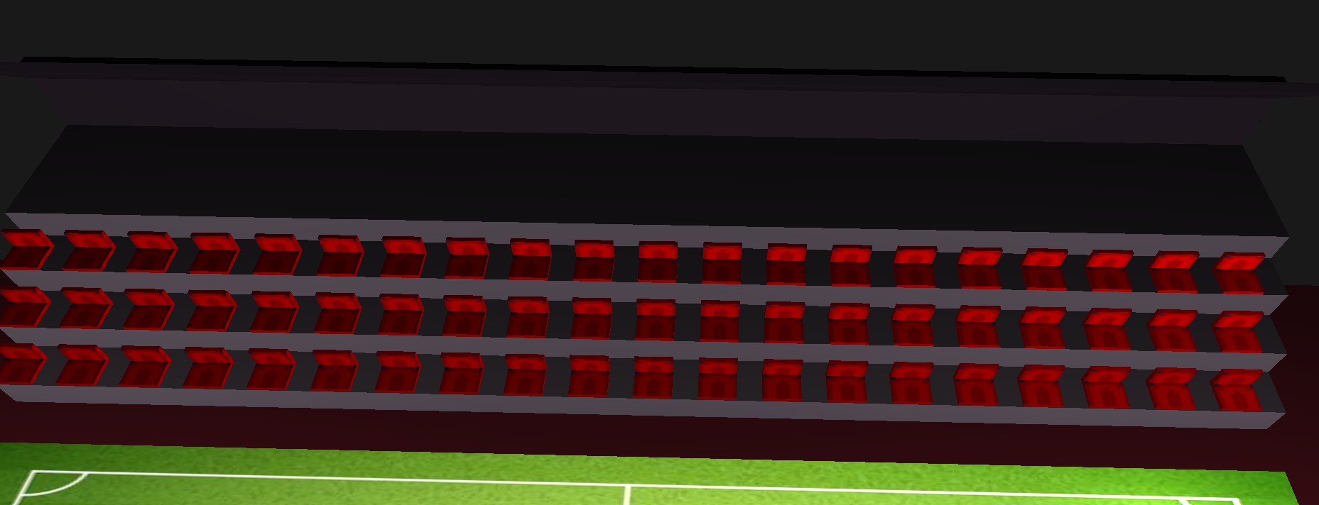
Different views of stadium
West Gallery
Fig 1.7: East Gallery

Slide 9
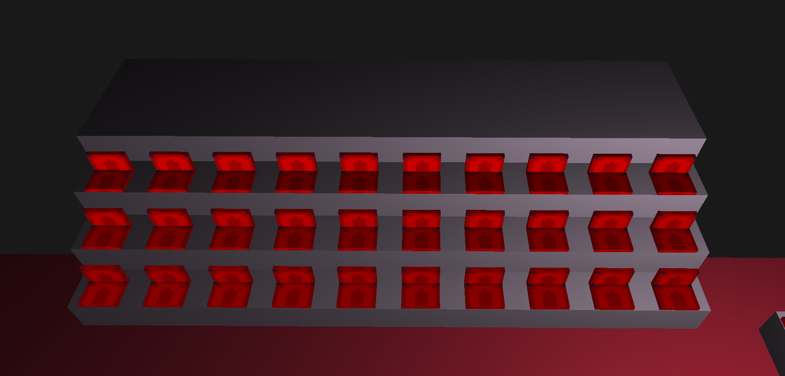
Different views of stadium
North and South Gallery
Fig 1.8: North and South Gallery

Slide 10
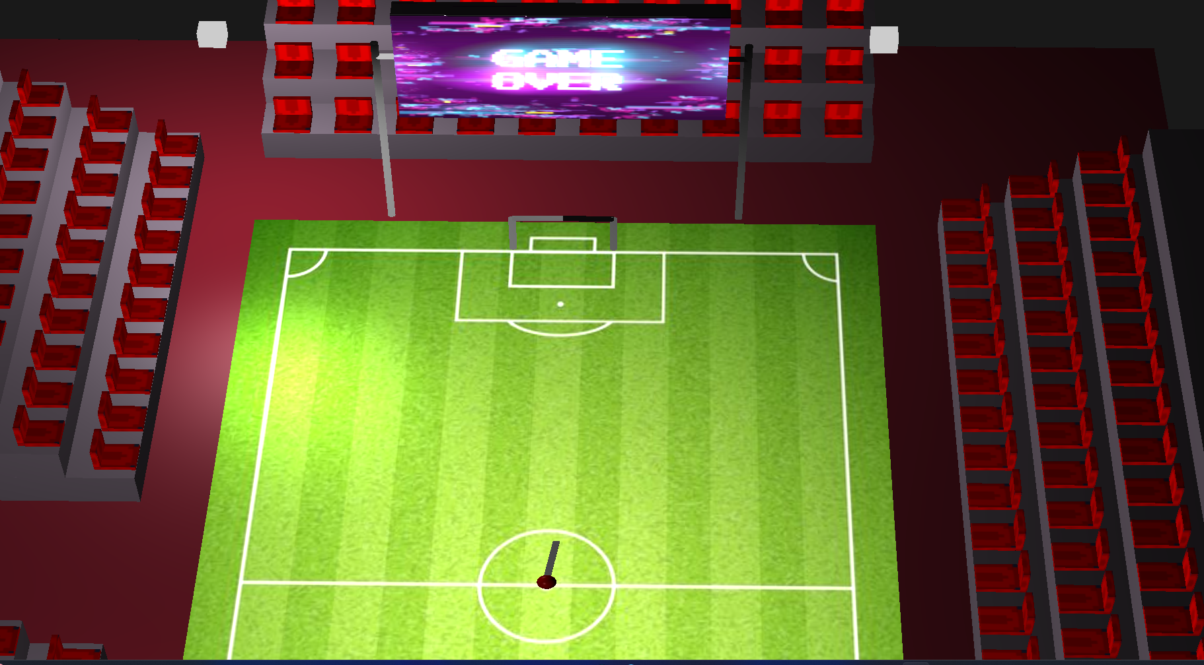
Different views of stadium
Game over state
Fig 1.9: Game over state

Slide 11
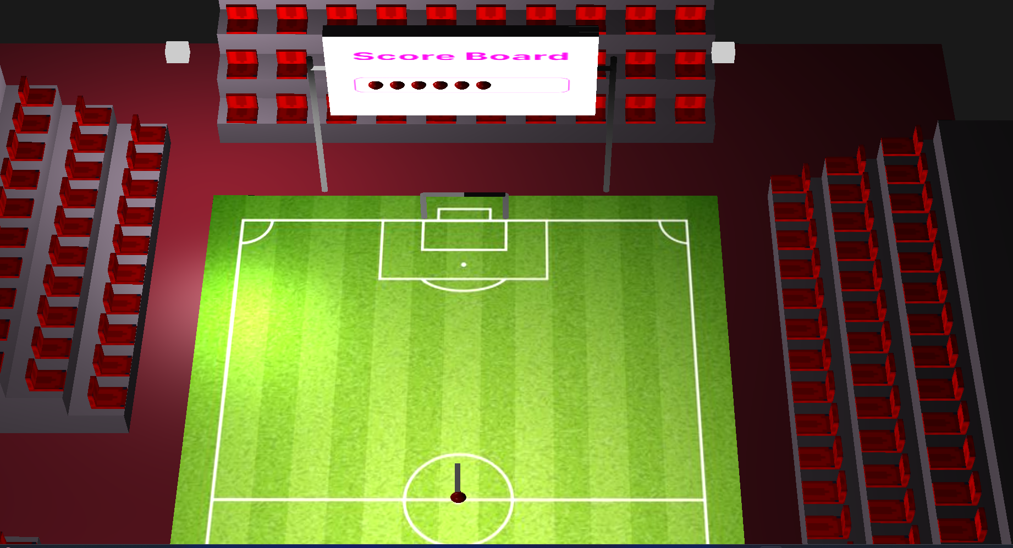
Different views of stadium
The ball will go to the direction where the arrow is pointing. We can change the direction of the arrow.
Fig 1.10: playing game state

Slide 12
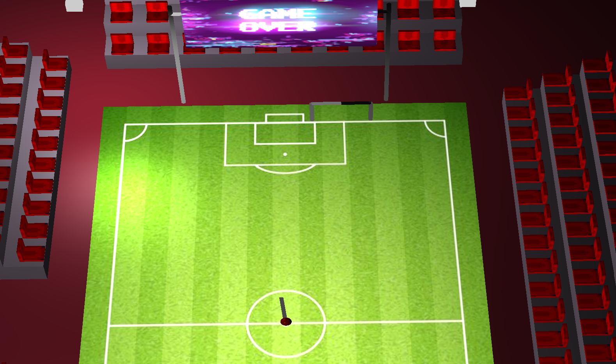
Different views of stadium
In the higher difficulty, the bar starts to move right and left. The speed of this movement varies with difficulty level.
Fig 1.11: Playing game with higher difficulty

Slide 13
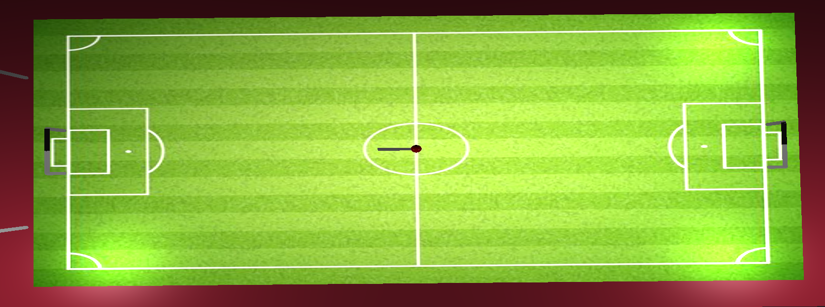
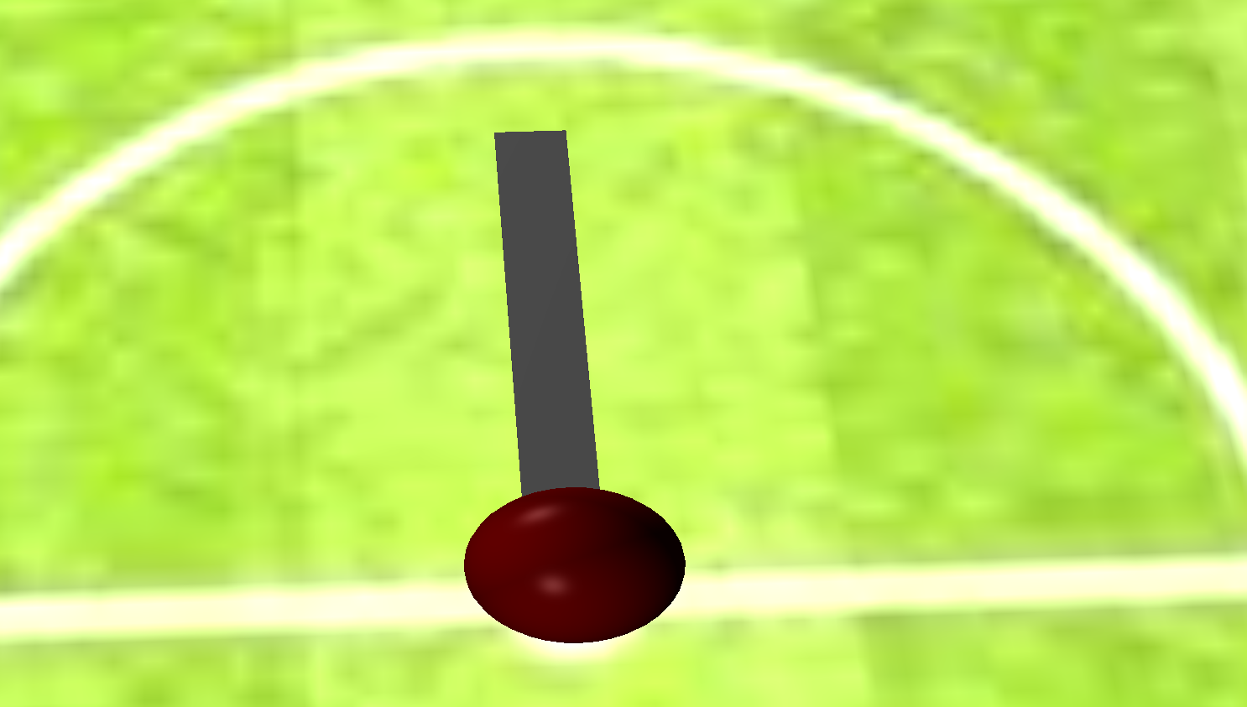
Different views of stadium
Field & Ball
Fig 1.12: Field view
Fig 1.13: Ball view with arrow

Slide 14
Control Keys
Key | Function
ESCAPE | Close window
W | Forward
S | Backward
D | Right
M | YAW_R
N | YAW_L
J | Left move of Ball angle
Right | Right move of Ball angle
G | Ball shooting
I | Difficulty level 1
O | Difficulty level 2
P | Difficulty level 3
2 | Toggling point light

Slide 15
Control Keys
Key | Function
3 | Toggling spot light
1 | Toggling directional light
4 | Ambient property
5 | Diffuse property
6 | Specular property

Slide 16
Conclusion
While the project presented some challenges during implementation, the learning curve was impressive. I believe the knowledge acquired while working on this project will be instrumental in tackling more complex graphical projects in the future.

Slide 17
References
https://learnopengl.com/Getting-started/OpenGL
Ed Angel, (2013), Introduction to Modern OpenGL Programming [PowerPoint slides], University of New Mexico. https://www.google.com/url?sa=i&rct=j&q=&esrc=s&source=web&cd=&cad=rja&uact=8&ved=0CAIQw7AJahcKEwiQmpaO9feAAxUAAAAAHQAAAAAQAg&url=https%3A%2F%2Fwww.cs.unm.edu%2F~angel%2FSIGGRAPH13%2FAn%2520Introduction%2520to%2520OpenGL%2520Programming.pptx&psig=AOvVaw2kK85Jyj7mtAWvopHq2SLZ&ust=1693056429705470&opi=

Slide 18
Thank You

